Slide 1
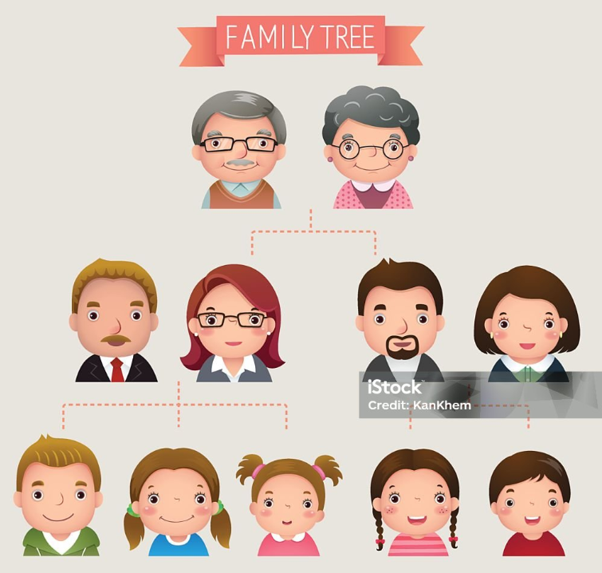

Slide 2
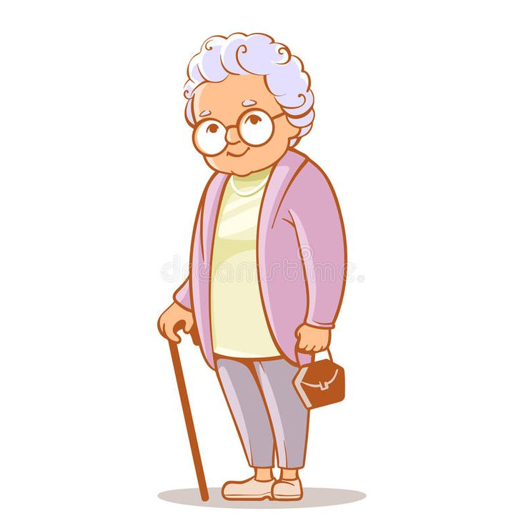
Babička
Grandmother
Granny
Grandmum

Slide 3
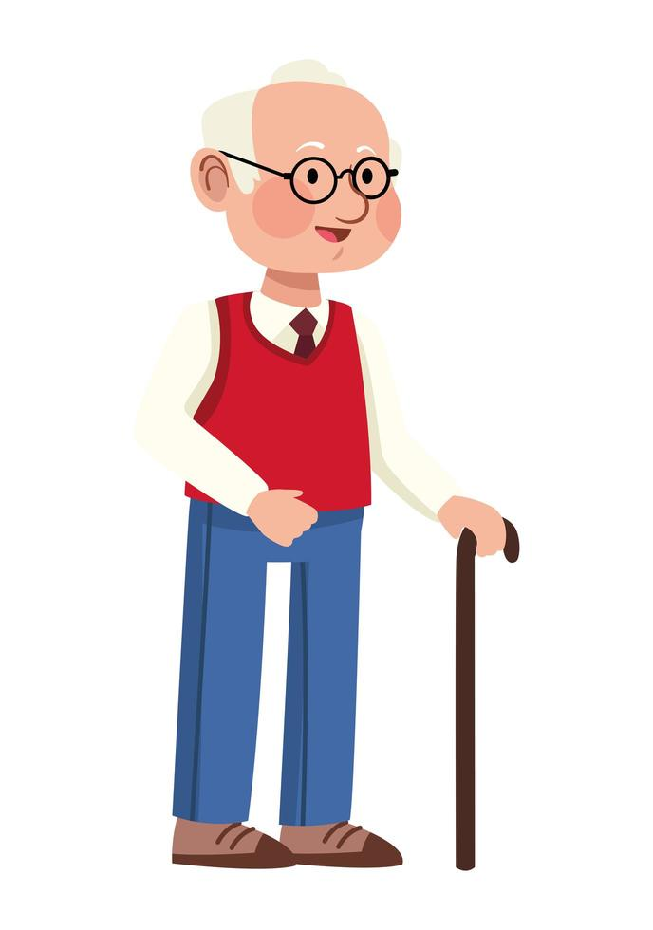
Dědeček
Grandfather
Granddad
Grandpa

Slide 4
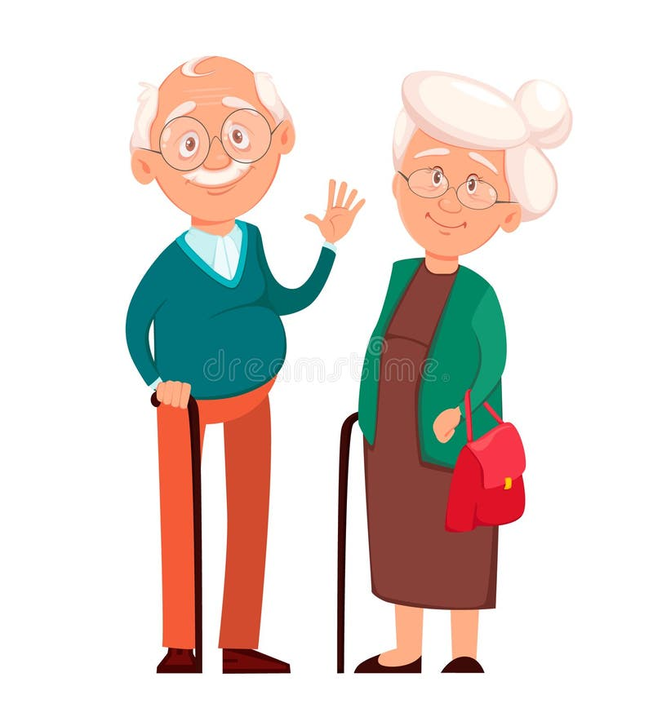
Prarodiče
Grandparents

Slide 5
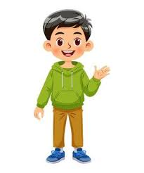
Vnuk
Grandson

Slide 6
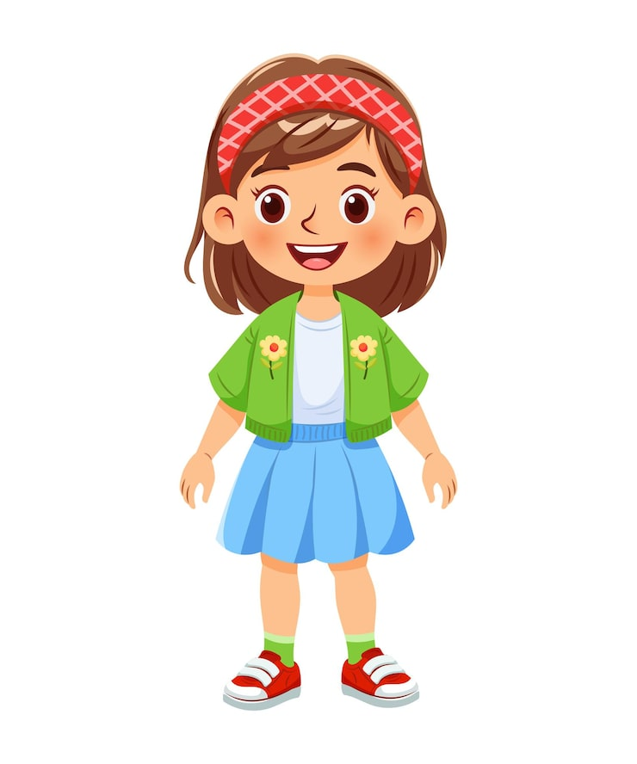
Vnučka
Granddaughter

Slide 7

Maminka a dcera
Mother
Mum
Daughter

Slide 8
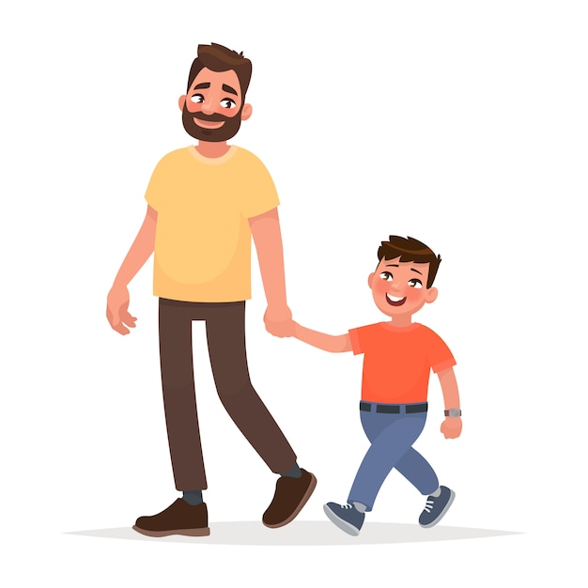
Tatínek a syn
Father
dad
Son

Slide 9
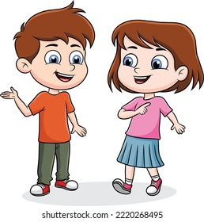
Děti
Vnoučata
Children
Grandchildren

Slide 10
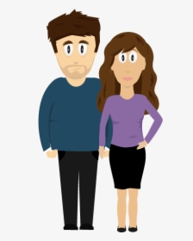
Rodiče
Parents

Slide 11
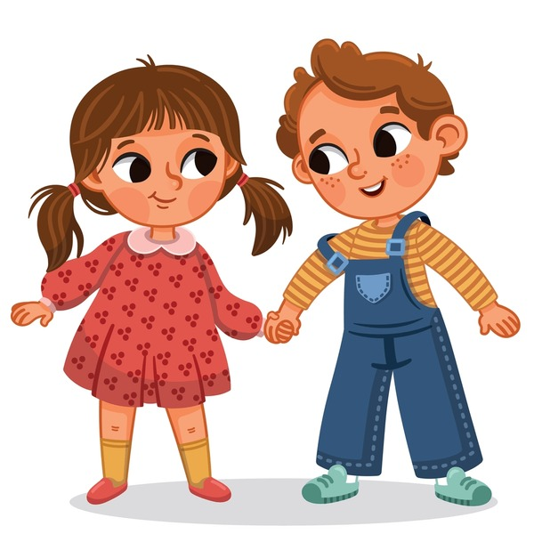
Bratr a sestra
Brother and sister

Slide 12
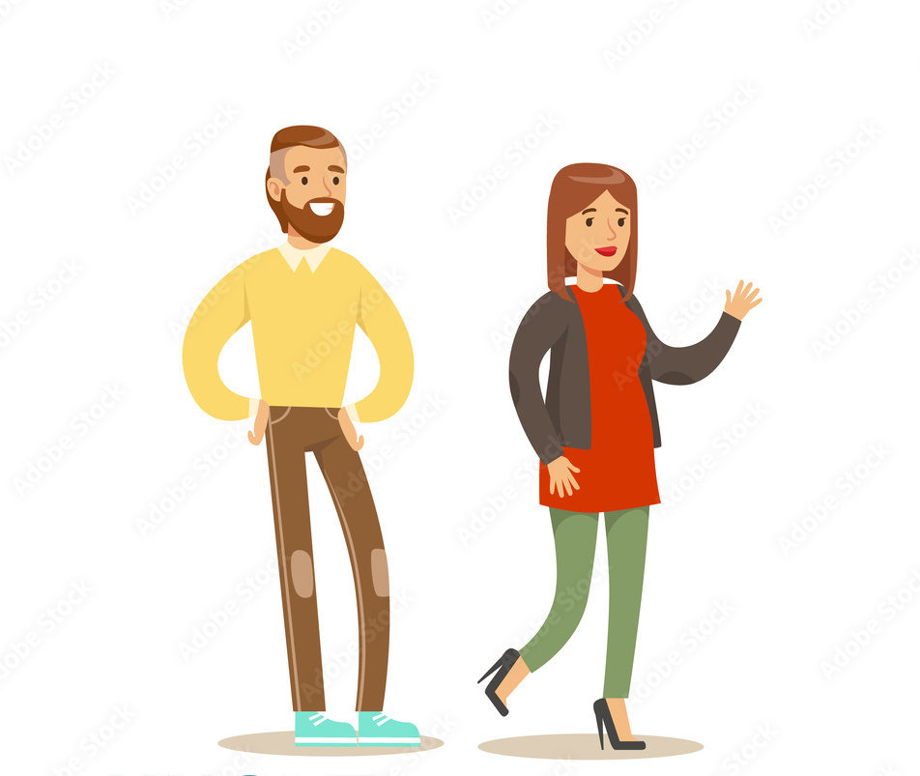
Strýc a teta
Uncle and aunt

Slide 13
Strýc a teta
Uncle and aunt

Slide 14
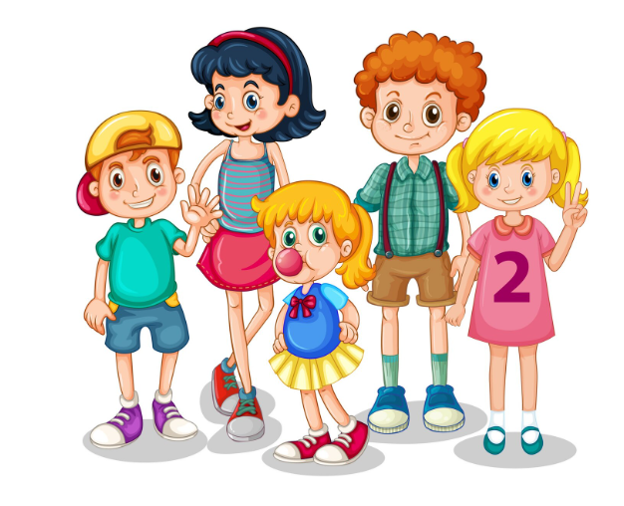
Bratranci a sestřenice
Cousins

Slide 15
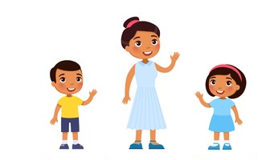
Synovec a neteř
Nephew and Niece

Slide 16
Grandfather
Grandmother
Mother
Father
Uncle
Aunt
Me
Brother
Sister
Cousin
Cousin

